Slide 1
Mental Health, Level 1
Before class, answer the questions in your book on page 3.
Capable Caregiving for Mental Wellness
Notes:
The images in this PowerPoint are licensed to DSHS/ALTSA. Images within this presentation may not be used for any other purpose.
This presentation requires the use of the Mental Health, Level 1 Capable Caregiving for Mental Wellness INSTRUCTOR GUIDE. Please refer to the instructors guide for following this presentation.
This presentation should not be modified with exception of the agenda for a modified start time.
DSHS-version: DRAFT 02-05-18

Slide 2
Agenda 9:00 AM – 5:00 PM
9:00 | Introductions & Housekeeping
 | Lesson 1: Mental Disorders
 | Lesson 2: Compassionate and Trauma-Informed Care
11:30 | Break
 | Lesson 3: Supports for Wellness
 | Lesson 4: Getting Help and Self-Care
 | Lesson 5: Suicide Prevention
1:00 | Lunch
 | Lesson 6: Communication Dynamics
 | Lesson 7: Boundaries
2:30 | Break
 | Lesson 8: Approaching Behaviors
 | Lesson 9: Crisis Management
4:30 | Exam
Notes:
*This slide may be modified.
Times can be set back one hour if there is a 8:00 am start time.

Slide 3
Module 1: Intro to Mental Disorders
Lesson 1: Mental Disorders
Page 4

Slide 4
1: Mental Disorders
The caregiver will review definitions, common signs and symptoms and identify types of mental illness.
Page 5

Slide 5
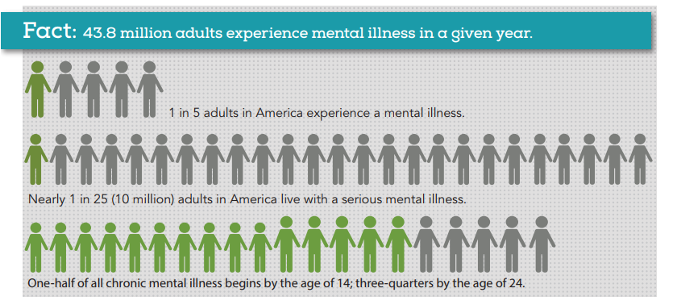
Fact
Source: Nami.org
Page 5
Notes:
Source: https://www.nami.org/NAMI/media/NAMI-Media/Infographics/GeneralMHFacts.pdf

Slide 6
Just Get Better
Video Resource
Notes:
Media
Play Video: What It’s Like to Hear “Just Get Better” (2:15)
https://www.youtube.com/watch?v=FbOmiMXBr1E&feature=youtu.be
Alternate Presentation: (if no internet connection)
Visualization: Imagine given a jar of peanut butter and an oversized spoon with a larger spoon head than will fit into the jar of peanut butter and you are asked to scoop the peanut butter out of the jar. You can’t do it.
Someone asks you – are you really trying? Do you really want it even? You’re going to give up just like that? Don’t you think that’s selfish?
If you were depressed and you said are you really trying? That’s how it would feel.

Slide 7
Reflect on how mental illness has touched your life – at work, at home, with friends, with strangers, or even your own mental illness. Reflect on how you currently feel about mental illness.
Page 5

Slide 8
Diagnosing Mental Disorders
It is not a caregiver’s job to diagnose a person with a mental disorder.
Page 6

Slide 9
Stigma and Myths
Stigma affects how others treat a person with a mental disorder.
Page7
Notes:
5 ways to reduce mental health stigma
https://www.youtube.com/watch?v=5MG_HDNqZA0
(4:01)
AsapTHOUGHT
Learn to stop perpetuating mental health stigma.

Slide 10
You just learned about a man who will soon be in your care named Sherwood Wycoff. He is a 76-year-old man with schizophrenia. You have no other information yet on Sherwood, but you have heard that schizophrenia makes people dangerous, violent and unpredictable. What can you do to separate yourself from this stigma so that you can provide the best care possible for Sherwood?
Page 7

Slide 11
Myths and Facts
Mental illness is a medical condition.
Page 8

Slide 13
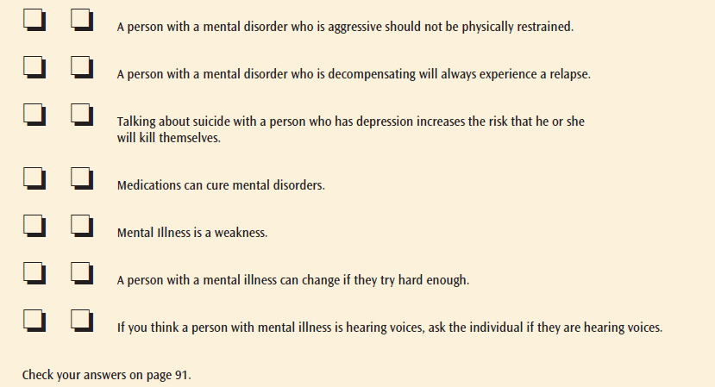

Slide 14
Mental Health Conditions
Be aware of conditions so you can understand individuals and make better decisions regarding their care.
Page 9
Notes:
Media
Play Video: Living with a mental disorder
(3:16)
https://youtu.be/ezI2W32yNg8
Alternate Presentation: (if no internet connection)
No alternate presentation.

Slide 15
Anxiety Disorders
Worry and fear of real or perceived threat…
Page 10-12

Slide 16
What is your attitude about this disorder?
How can you be supportive of people with this disorder?
Page 12

Slide 17
Depression
Involves the body, mood and thoughts
Page 13

Slide 18
What is your attitude about this disorder?
How can you be supportive of people with this disorder?
Page 13

Slide 19
Bipolar
Unusual shifts in mood, energy and ability to function.
Page 14

Slide 20
What is your attitude about this disorder?
What are the facts about this disorder?
How can you be supportive of people with this disorder?
Page 14

Slide 21
Borderline Personality Disorder
Problems regulating emotions and thoughts, moods… impulsive and reckless behaviors… unstable relationships
Page 15
Notes:
Media:
https://youtu.be/3BW10FmlsXg

Slide 22
What is your attitude about this disorder?
What are the facts about this disorder?
How can you be supportive of people with this disorder?
Page 16

Slide 23
Obsessive-compulsive Disorder
Repetitive, unwanted, intrusive thoughts and irrational, excessive urges to do certain actions…
Page 17

Slide 24
What is your attitude about this disorder?
How can you be supportive of people with this disorder?
Page 17

Slide 25
Post-traumatic Stress Disorder
Some people who experience a shocking, scary or dangerous event…
Page 18

Slide 26
What is your attitude about this disorder?
How can you be supportive of people with this disorder?
Page 18

Slide 27
Schizophrenia
Interferes with ability to think clearly, manage emotions, make decisions and relate to others…
Page 18-19
Notes:
Media
Play Video: Anderson Cooper tries a schizophrenia simulator
(5:03)
https://youtu.be/yL9UJVtgPZY
Alternate Presentation: (if no internet connection)
No alternate presentation.

Slide 28
What is your attitude about this disorder?
How can you be supportive of people with this disorder?
Page 19

Slide 29
Lesson 1
Page 22

Slide 30
Module 2: Caregiving for Individuals with Mental Disorders
Lesson 2: Compassionate and Trauma-Informed Care
Lesson 3: Supports and Wellness
Lesson 4: Getting Help and Self-Care
Page 23

Slide 31
2: Compassionate and Trauma-Informed Care
The caregiver will recognize that culture; generation, religion/spirituality and past trauma experiences can affect current thinking, behaviors and actions and identify strategies to provide informed care and support resilience.
Page 24

Slide 32
Take a few minutes and consider the things that you would like others to know about you. Here are some topics to get you started.
Surface level:
Age, gender, physical features, food preferences, clothing…
Below the surface:
Spirituality, thoughts on aging, sense of self, rules for social interaction, decision-making, perceptions on mental disorders, perceptions on disability, perceptions of roles related to age, gender, class…
How do you respond when others have different thoughts, views and perceptions than you?
How do you feel when others assume you have similar beliefs based on your gender, age, physical features, etc?
Page 25

Slide 33
Culture and Ethnicity
Culture can influence mental health and the treatment of mental disorders.
Page 24

Slide 34
58 year-old Burma Zambrano has many symptoms of depression. She denies having a mental disorder. It is her belief that mental illness is actually something evil that is trying to harm or destroy her. She seeks help from reading her bible and attending church.
How might you support Burma?
Page 24

Slide 35
Trauma-Informed Care
Repeated, chronic, significant or multiple traumas
Substance abuse, mental illness and health problems
Page 26
Notes:
Media
Play Video: Trauma Informed Care 6
(5:04)
https://youtu.be/-4j7o2YY05s

Slide 36
Trauma-Informed Approach
Realize the impact,
recognize the signs, respond and
seek to resist re-traumatization
Page 28

Slide 37
Tommie Callihan, age 83, diagnosed with post-traumatic stress disorder (PTSD) that surfaced after a long service in the military. He started experiencing outbursts of anger, survivor’s guilt and extreme difficulty with opposite sex relationships and frequent overpowering flashbacks 15 years ago. Tommie tried to keep these symptoms to himself and managed them on his own. The recent move into a care setting has triggered intense flashbacks and other symptoms.
How can you support Tommie?
Are there activities or tasks that you perform in your job that might re-traumatize Tommie?
Page 28

Slide 38
Resilience
Promote resilience by encouraging individual strengths.
Page 29

Slide 39
Lesson 2
Page 30

Slide 40
Break

Slide 41
3: Supports for Wellness
The caregiver will identify possible medication side effects, ways to respond to side effects and recognize individualized non-drug therapies to alleviate symptoms of mental illness.
Page 31

Slide 42
You are a new caregiver and you focus on completing a list of tasks and forget to acknowledge the individuals you care for. Your mind is focused on the tasks and not the person as an individual.
Discuss how this might make you feel.
How do you think it would make the person you care for feel?
Page 31

Slide 43
Baseline
Managing symptoms and functioning at own highest level.
Page 31

Slide 44
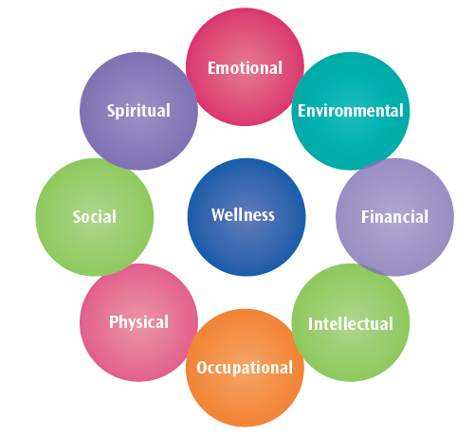
Eight Dimensions of Wellness
Page 32

Slide 45
Person-Centered Planning
Placing the person at the center and above all other aspects of the treatment process.
Page 32

Slide 46
Conventional Medicine
Medications used for mental disorders do not cure mental disorders and conditions.
Page 33

Slide 47
Dalton Countryman, an 88 year old man with Generalized Anxiety Disorder just started a new anti-anxiety medication* a week ago. Today, you notice that his lips are swollen and he is having trouble breathing. What can you do?
*see page 38
Page 39

Slide 48
Chemical Restraints & Refusal
Chemical Restraint
is considered abuse
in the state of Washington
… Individuals have the right to refuse medication.
Page 40

Slide 49
Non-Drug Therapies
Talk Therapy
Aromatherapy
Exercise
Music therapy
Naturopathic medicine
Nutritional healing
Supplements
Massage
Support Groups
Yoga
Acupuncture
Page 40-43

Slide 50
Discuss other non-drug therapies that may have worked for you or others in the past. Write down up to four (4) new ideas not listed in this lesson.
Page 43

Slide 51
Lesson 3
Page 44

Slide 52
4: Getting Help and Self-Care
The caregiver will recognize the importance of caregiver wellness and identify strategies to prevent secondary trauma and burnout.
Page 45

Slide 53
Imagine leaving your house in the morning. You have everything you need for your day. You have your keys in your hand and you get into your car. You try to start the car. The car will not start. Your car is out of gas. Can you expect to get to where you are going?
Page 45

Slide 54
Caregiver Mental Wellness
Find ways to nurture yourself.
Page 45

Slide 55
Identify ways that you currently take care of your personal wellness.
Identify one (1) new routine you will add that will benefit your personal wellness.
Page 45

Slide 56
Secondary Trauma
Exposure to another individual’s traumatic experiences.
Page 46

Slide 57
Strategies to Cope with Burnout
Make and take time for yourself.
Page 46-47
Notes:
Media
Play video: Mini meditations | Let go of stress
https://youtu.be/PFZ6C2XhJAc
(1:10)

Slide 58
Lesson 4
Page 50

Slide 59
Module 3: Suicide
Lesson 5: Suicide Prevention
Page 51

Slide 60
Lesson 5: Suicide Prevention
The caregiver will identify suicide facts, recognize warning signs and communicate about suicide.
Page 52

Slide 61
Reflect on your thoughts and attitudes about suicide. How do you think these thoughts and attitudes will influence the care you provide for someone who is considering suicide?
Page 52

Slide 62
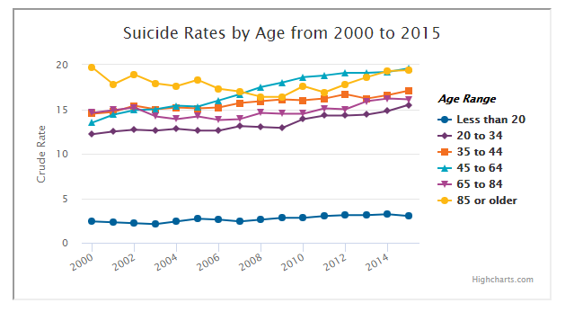
Facts About Suicide
Page 52
Source: afsp.org / CDC Data and Statistics Fatal Injury Report for 2015

Slide 63
Risk Factors and Warning Signs
Suicide is more common when stress is greater than the ability to cope with a mental disorder.
Page 52

Slide 64
Talking About Suicide
If you think that someone is thinking about suicide, assume you are the only one who will reach out.
Page 55

Slide 65
Have a neighbor discussion about your role in dealing with an individual who is suicidal. Share highlights with the class.
Page 55

Slide 66
After Suicide
Immediately call 911 after a loss.
Page 56

Slide 67
Grief Support
Having support of other people is vital to the healing from loss.
Page 58

Slide 68
Lesson 5
Page 59

Slide 69
Lunch

Slide 70
Module 4: Respectful Communication
Lesson 6: Communication Dynamics
Lesson 7: Boundaries
Page 60

Slide 71
Lesson 6: Communication Dynamics
The caregiver will demonstrate an ability to recognize communication styles and ways to communicate effectively.
Page 61

Slide 72
Think about a communication you have had recently with someone at work. Reflect on how your own past experiences, traumatic events, traditions, culture, religion and spirituality influenced your part of the conversation. From what you know about the other person, reflect on how these same topics influenced their part of the conversation.
Page 61

Slide 73
Respectful Communication
Remain open and genuine in your communication
Page 61

Slide 74
Listening
Listening requires more than hearing words.
Page 62

Slide 75
Pair up in groups of two.
Learner #1: This individual will speak for one minute about something that happened to them recently.
Learner #2: This individual will listen for one minute practicing the listening skills listed above.
After the minute is up, switch roles for one minute.
Page 62

Slide 76
Empathy and Compassion
Compassionate, empathetic people are able to listen to and understand the experiences that other people describe.
Page 63

Slide 77
Eliseo Hiler, a 65 year old man with depression seems to be more withdrawn today and you see him watching others work on a project together. How might you interact with Eliseo to find out how he is really feeling?
Page 63

Slide 78
Communication for Specific Disorders
Anxiety
Depression
Bipolar
Schizophrenia
Page 64-66

Slide 79
Anxiety
Pair up with a partner and complete this activity:
Each individual will choose one of the roles below.
Caregiver
Jackie Vanderhoff – Age 55, diagnosed with anxiety panic disorder (page 10).
Scenario: The caregiver walks into the room to see Jackie Vanderhoff starting to hyperventilate and exclaims, “I am going to die!” Jackie seems agitated and pacing back and forth.
Role-play the scenario above. The learner playing the “caregiver “will demonstrate compassion, flexibility and understanding for the individual. The learner playing “Jackie” will act anxious.
Page 64

Slide 80
Communication for Specific Disorders
Anxiety
Depression
Bipolar
Schizophrenia
Page 64-66

Slide 81
Depression
Pair up with a partner and complete this activity (switch roles from last time):
Each individual will choose one of the roles below.
Caregiver
Devin Sollars – Age 80, diagnosed with depression (page 15).
Scenario: The caregiver walks into the room to see Devin Sollars sitting in a chair staring blankly at the wall. The caregiver has noticed that Devin has been more and more withdrawn lately and not participating in activities. Devin is struggling to find anything positive to look forward to.
Role-play the scenario above. The learner playing the “caregiver “will demonstrate compassion, flexibility and understanding for the individual. The learner playing “Devin” will act depressed.
Page 65

Slide 82
Communication for Specific Disorders
Anxiety
Depression
Bipolar
Schizophrenia
Page 64-66

Slide 83
Bipolar
Pair up with a new partner and complete this activity:
Each individual will choose one of the roles below.
Caregiver
Lawerence Ocasio – Age 66, diagnosed with bipolar disorder (page 13).
Scenario: At lunch, Lawerence is pacing near the table and then sits down and then quickly stands back up again. Lawerence seems to have a lot of extra energy and seems to be elated/happy. The caregiver notices this and approaches Lawerence.
Role-play the scenario above. The learner playing the “caregiver “will demonstrate compassion, flexibility and understanding for the individual. The learner playing “Lawerence” will act bipolar.
Page 65

Slide 84
Communication for Specific Disorders
Anxiety
Depression
Bipolar
Schizophrenia
Page 64-66

Slide 85
Schizophrenia
Pair up with a partner and complete this activity (switch roles from last time):
Each individual will choose one of the roles below.
Caregiver
Kelley Pooley – Age 43, diagnosed with schizophrenia (page 18).
Scenario: Kelley Pooley rushes up to the caregiver and exclaims “Help! There is a man with a knife in my room.” Kelley laughs.
Role-play the scenario above. The learner playing the “caregiver “will demonstrate compassion, flexibility and understanding for the individual. The learner playing “Kelley” will act out symptoms of schizophrenia.
Page 66

Slide 86
Triggering and Preventing Challenging Behaviors
Be aware of the meaning of our words and the impact of our words on others.
Page 66-67

Slide 87
Read the phrases below and think about how you can reframe as a positive.
You constantly interrupt when I am talking.
You always make mistakes like that.
You can’t leave.
Try to do better next time.
Page 67

Slide 88
Lesson 6
Page 68

Slide 89
Lesson 7: Boundaries
The caregiver will demonstrate an understanding of creating healthy professional boundaries.
Page 69

Slide 90
Reflect on a time when you felt like someone was intruding on your personal boundaries making you feel uncomfortable with their actions or words.
Page 69

Slide 91
Professional Boundaries
Boundaries can apply to coworkers, managers and even the individuals you care for.
Page 69

Slide 92
Read the questions on page 70.
Identify the questions that might indicate boundary violation.
If the answer is yes, discuss why.
Page 70

Slide 93
Setting Boundaries
As the gatekeeper, you get to decide how close another person gets to you physically and emotionally.
Page 71

Slide 94
Identify the boundaries below as emotional or physical by placing an “E” next to those that are emotional and “P” next to those that are physical.
____ You will not be manipulated or forced to do things you don’t want to do, even if the other person is attempting to make you feel guilty.
____ You keep your emotions separate from other people’s emotions, although you empathize with the people you care about.
____ Knowing that you have the choice in how you want to feel and your ability to act on it.
____ When someone intrudes on our physical space, we feel it internally. It feels awkward and unnatural.
____ When someone goes through another person’s belongings without their permission.
E
E
E
P
P
Page 72

Slide 95
Assertiveness
Aggressive
Passive
Assertive
Page 72-73

Slide 96
Lesson 7
Page 73

Slide 97
Break

Slide 98
Module 5: Creative Approaches to Challenging Behaviors
Lesson 8: Approaching Behaviors
Lesson 9: Crisis Management
Page 74

Slide 99
Lesson 8: Approaching Behaviors
The caregiver will demonstrate a sequence of steps to approach challenging behaviors.
Page 75

Slide 100
Think about a time when your own behaviors were negative and how you felt at that time. Consider how others reacted or responded to your behaviors. Were there responses that made you feel better? Were there reactions that made you feel worse?
Page 75

Slide 101
Exploring Behaviors
Individuals with mental illness use behaviors to communicate a personal need, feelings and emotions.
Page 75

Slide 102
Strategy for Approaching Behaviors
Stop
Identify
Action
1
2
3
Page 75

Slide 103
Strategy for Approaching Behaviors
Stop
Stop or pause
Calm yourself
1
Page 75

Slide 104
Strategy for Approaching Behaviors
Janeth Mcfarren recently started telling you about having conversations with her family in California. She does not have a phone and there is no record of these conversations. After talking with the family, you discover that she has hallucinated in the past when there is a change in her environment. You have just had several staff change their schedule and some of Janeth’s favorite activities have changed.
Discuss how you can accomplish step one.
1
Page 76

Slide 105
Strategy for Approaching Behaviors
Identify
What need or desire does the individual have that is not being met?
What are the physical, environmental, and emotional triggers?
Were other people involved?
Is this a new behavior?
Are there any patterns that you can see?
What happened just before the behavior started?
2
Page 76-77

Slide 106
Strategy for Approaching Behaviors
Janeth Mcfarren recently started telling you about having conversations with her family in California. She does not have a phone and there is no record of these conversations. After talking with the family, you discover that she has hallucinated in the past when there is a change in her environment. You have just had several staff change their schedule and some of Janeth’s favorite activities have changed.
Discuss how you can accomplish step two.
2
Page 77

Slide 107
Strategy for Approaching Behaviors
Action
Adapt
Give space
Soothe and comfort
Reassure
Distract or redirect
Encourage
Protect and support others
Get help
Minimize or eliminate triggers
3
Page 77-80

Slide 108
Strategy for Approaching Behaviors
Janeth Mcfarren recently started telling you about having conversations with her family in California. She does not have a phone and there is no record of these conversations. After talking with the family, you discover that she has hallucinated in the past when there is a change in her environment. You have just had several staff change their schedule and some of Janeth’s favorite activities have changed.
Discuss how you can accomplish step three.
3
Page 80

Slide 109
Lesson 8
Page 82

Slide 110
Lesson 9: Crisis Management
The caregiver will identify potential stressors to prevent crisis and demonstrate steps for de-escalation.
Page 83

Slide 111
Consider what you know about trauma informed care, behaviors and communication so far. How do you think it influences crisis management?
Page 83

Slide 112
Crisis
Extreme emotional disturbance or behavioral distress, considering harm to self or others…
Page 83

Slide 113
Averting Crisis
There are usually early warning signs that signal problems.
Page 84

Slide 114
Kip Lehmann, an 85-year-old man with borderline personality disorder experiences wide mood swings and shows instability and insecurity. He has chronic feelings of boredom and emptiness. When he feels stressed, he often becomes angry and impulsive. Occasionally, Kip has self-harming behaviors.
Discuss any warning signs that you might watch for to avert a crisis.
Page 84

Slide 115
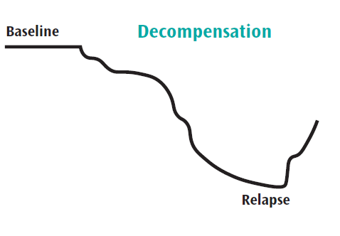
Decompensation
Early identification that the person is decompensating is vitally important to get the person appropriate treatment.
Page 84

Slide 116
Eula Griffiths, age 57, has post-traumatic stress disorder (PTSD) and has a history of self-harm and substance abuse. Over the last year, she has been managing her PTSD with a combination of medication and her service dog that has been soothing for her. Eula moved into a new care setting six months ago and there have been many recent changes in caregivers. She has become withdrawn and her symptoms of PTSD are increasing with more flashbacks, bad dreams and outbursts of anger. What are some ways you can help Eula?
Page 85

Slide 117
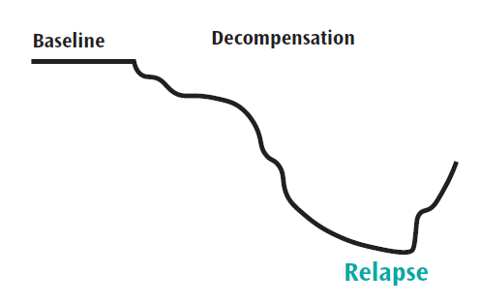
Relapse
Prepare ahead of time and develop a plan with the person on what to do in the event of a relapse.
Page 86

Slide 118
Eula Griffiths PTSD has relapsed and she is abusing substances and self-harming in addition to her increased symptoms of PTSD. She has a relapse plan in place. How can you help her?
Relapse Plan
Resident Name: Eula Griffiths
Events or situations that triggered relapse in the past:
Stressors that include change of environment, inconsistency in supports, the month of December, holidays, fireworks and other loud noises.
Early warning signs that I have experienced in the past:
Increased irritability, sleeplessness, avoiding social gatherings, feeling depressed, outbursts of anger.
What would help me if I experienced early warning signs?
Medications, talking with my therapist, my service dog, going for walks, support from family and friends, creating / art
Who I would like to assist me / what I would like them to do
My sister – talk with me about carefree memories from our childhood
My therapist – let me talk about my feelings and help me reframe my thoughts
My pastor – pray with me
Page 86

Slide 119
When Crisis Occurs
…in danger of physical injury, out of control, talking about suicide, posing a threat to the safety of other persons…
Page 87-88
Notes:
Video: https://youtu.be/PXZ-2u7wI7Q

Slide 120
Eula Griffiths elevated to crisis when she started threatening to kill herself and others around her. What can you do to help de-escalate the situation?
Page 88

Slide 121
Crisis Resources
If you need to call a mental health professional or the crisis team, remember to stay calm and…
Page 88-89

Slide 122
Alice has schizophrenia. Alice is experiencing visual hallucinations. She tells you that she sees men entering her windows and she thinks they are going to hurt her. Alice appears frightened. You are afraid for her safety as she is so distraught. You decide that it is time to call the mental health crisis team. What will you say?
Page 88

Slide 123
Lesson 9
Page 90

Slide 124
Exam and Evaluation

