Slide 1
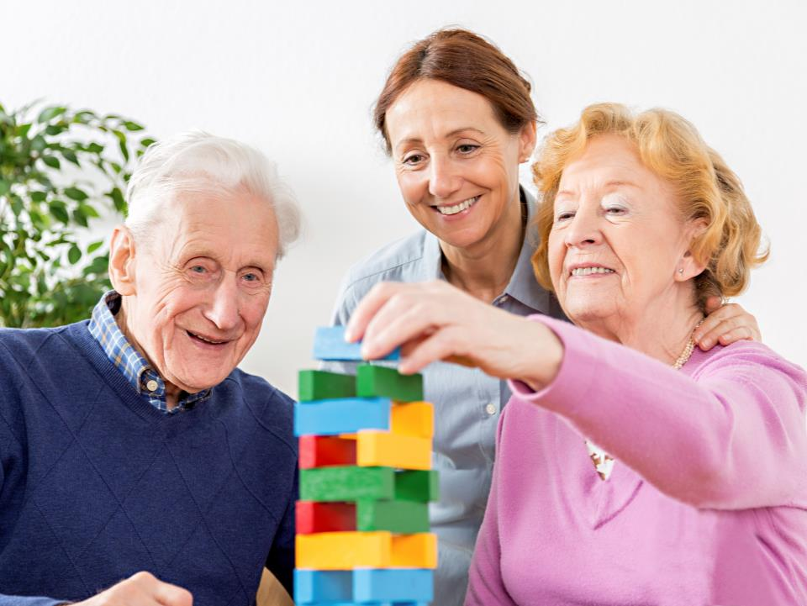
Dementia, Level 1
Dementia Capable Caregiving
Notes:
The images in this PowerPoint are licensed to DSHS/ALTSA. Images within this presentation may not be used for any other purpose.
This presentation requires the use of the Dementia, Level 1 Capable Caregiving INSTRUCTOR GUIDE. Please refer to the instructors guide for following this presentation.

Slide 2
Agenda 9:00 AM – 5:30 PM
9:00 | Introductions & Housekeeping
9:15 | Introduction to Dementia (60) Hallucinations and Delusions (15)
10:30 | Setting the Tone (30) Working with Families (15)
11:15 | Break
11:30 | Sexuality and Intimacy (30) Medications, Treatments and Therapies (30) Activities of Daily Living (30)
1:00 | Lunch
1:30 | Communication with People who Have Dementia (60) Trauma Informed Care (45)
3:15 | Break
3:30 | Approaching Challenging Behaviors (60) Tips for Dealing with Specific Challenging Behaviors (30)
5:00 | Test

Slide 3


Module 1: Understanding Dementia
Lesson 1: Introduction to Dementia
Lesson 2: Hallucinations and Delusions
Lesson 3: Setting the Tone
Lesson 4: Working with Families
Page 3

Slide 4
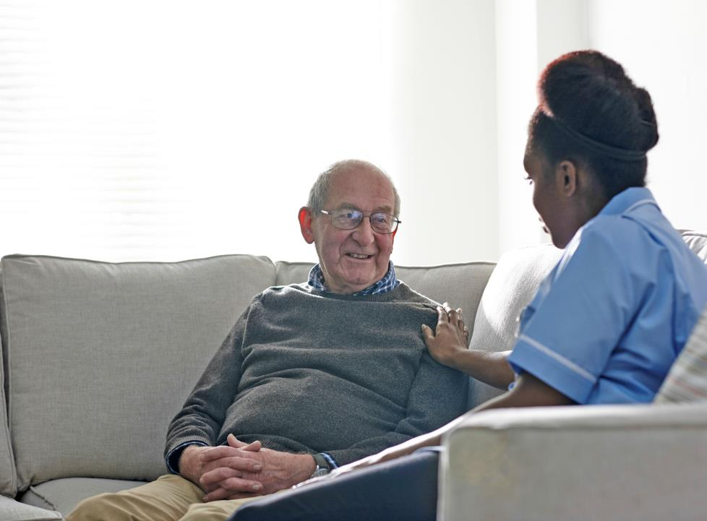
1: Introduction to Dementia
People will always remember how you made them feel.
Page 4

Slide 5
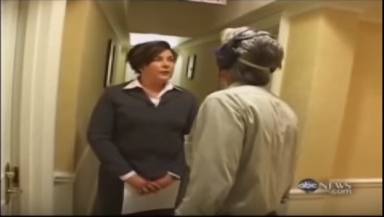
Step Into Dementia
Page 4

Slide 6
Americans Living with Alzheimer’s
16,000,000
2050
5,000,000 +
2015
Page 4

Slide 7

Not Dementia
Now… where did I put my
car keys?
Forgetfulness is a
lapse of memory
Page 5

Slide 8
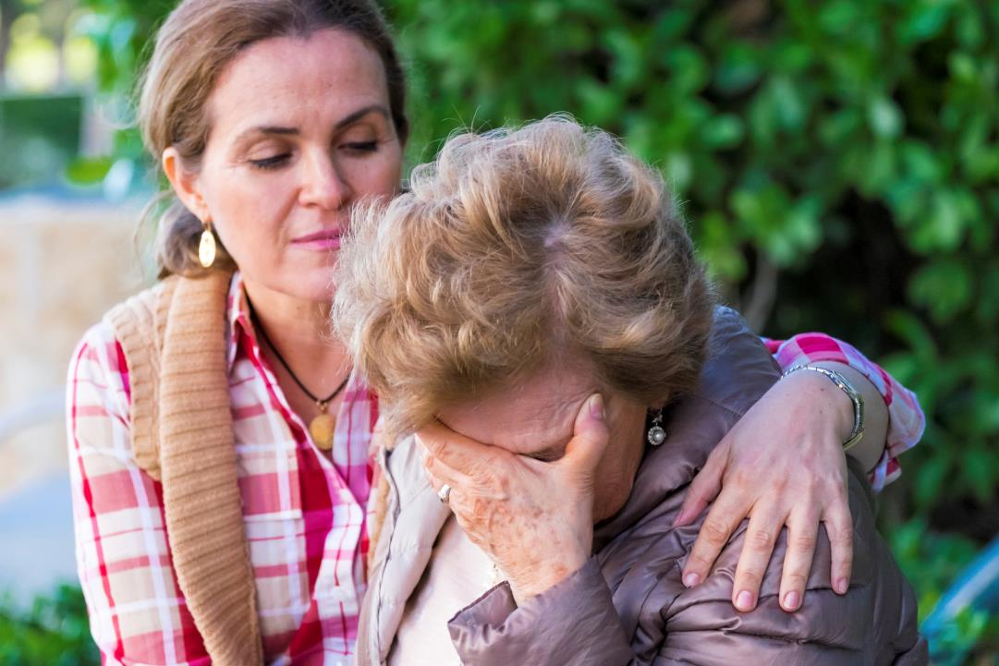
Not Dementia
Depression is a treatable illness that involves the body, mood, and thoughts.
Page 5

Slide 9
You have been caring for Mr. Miley for nearly six months. For the first several months, he was generally in a good mood and you would often find him gardening and visiting with his friends and family. Over the last two months, you notice he is sleeping more than usual and has gradually lost interest in gardening and spends time in his room. He is refusing visits with friends and family. You notice that over the last two weeks he is becoming increasingly angry and agitated toward others.
Highlight the symptoms that might look like depression.
Page 6

Slide 10

Not Dementia
I need medical attention!
Delirium is a medical condition characterized by severe confusion that starts quickly.
Page 6

Slide 11
Ms. Zellmer enjoys participating in activities and taking walks. She is generally in a good mood with occasional times of unhappiness. During this morning’s activity, she suddenly becomes agitated and confused about where she is at and what she is doing. Frantically, she swings her arms in front of her as if she were hitting at something. You know she just started a new medication.
Highlight the symptoms that might look like delirium.
Page 6

Slide 12

Not Dementia
UTI is an infection that is caused by
bacteria in part of the urinary tract.
Page 7

Slide 13
Claudia Combs, a 91-year-old woman with dementia complains of dizziness and you notice she has less energy than usual. One day you notice she takes an unusually long nap. When she wakes, she is more confused than usual and unable to dress herself.
Highlight the symptoms that might look like UTI.
Page 7

Slide 14

Not Dementia
MCI causes slight but noticeable and measureable decline in cognitive abilities.
Page 7-8

Slide 15
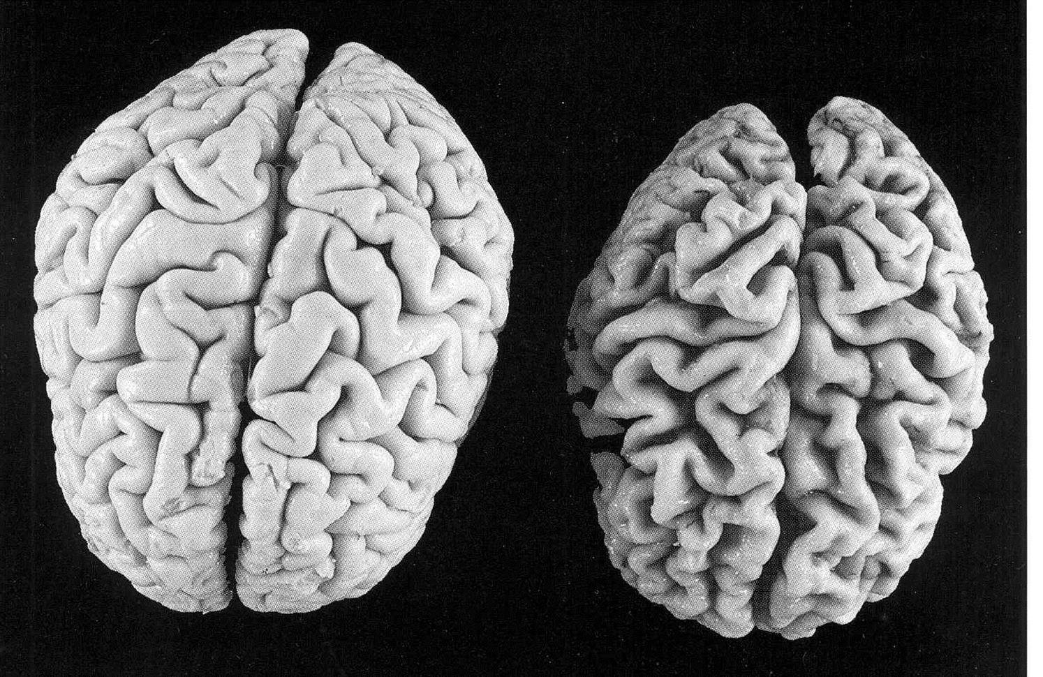
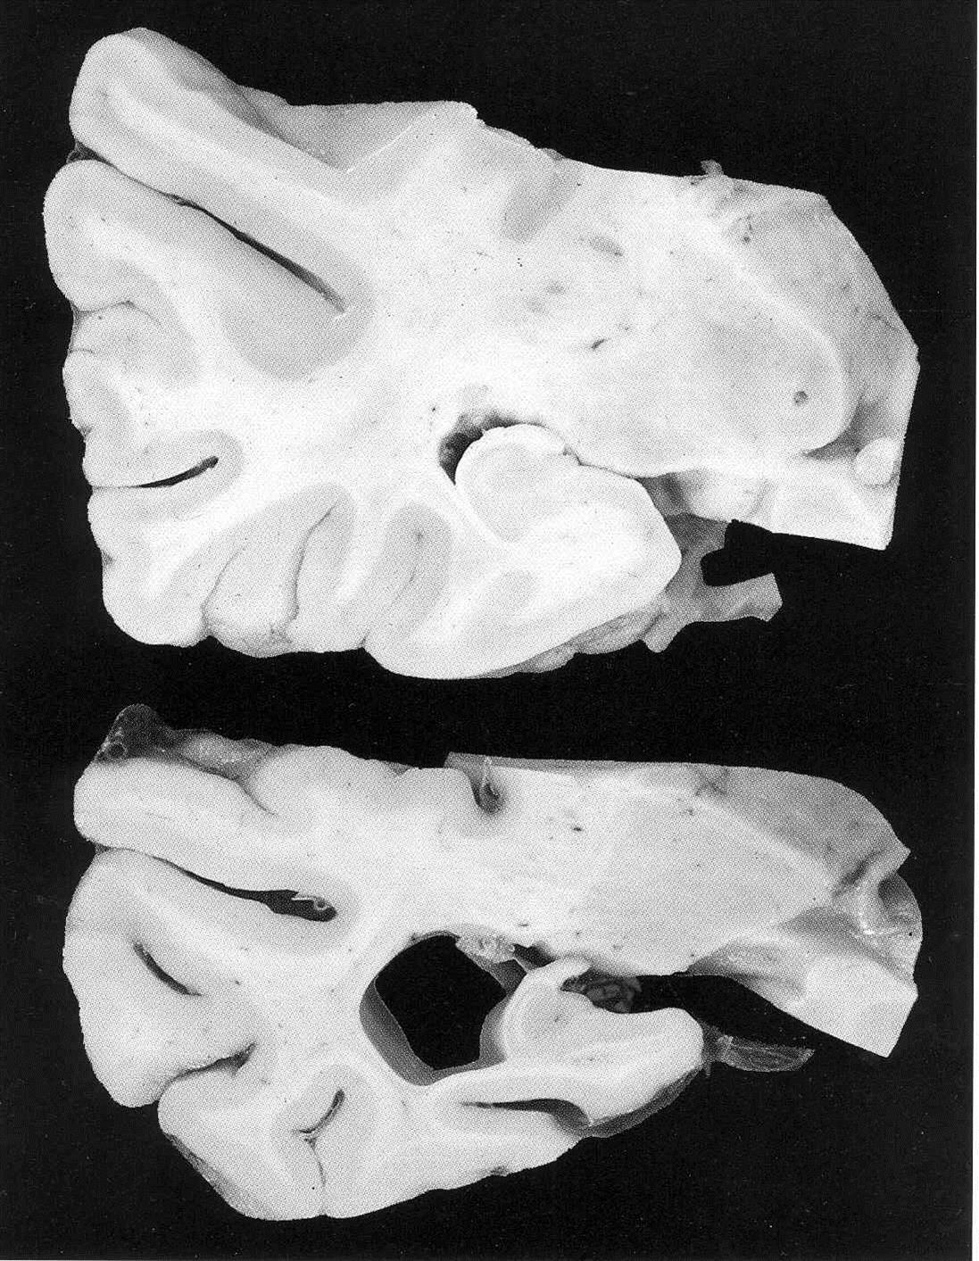
Dementia
symptoms
that result when
the BRAIN is DAMAGED
by disease, injury or illness.
Page 8

Slide 16
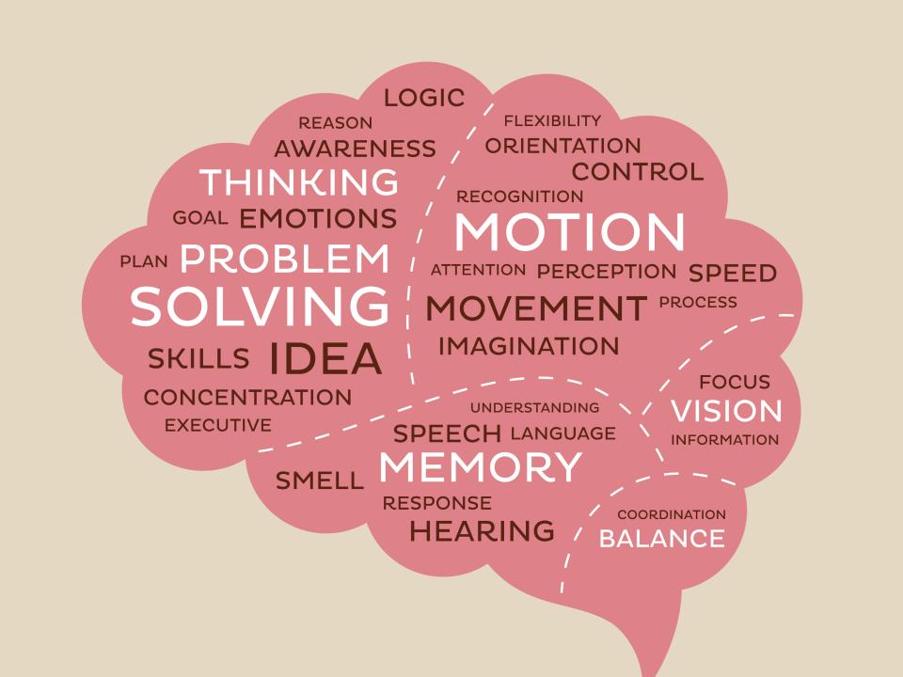
The Brain and Dementia
Frontal
Lobe
Parietal
Lobe
Occipital Lobe
Temporal Lobe
Cerebellum
Page 9

Slide 17
Types of Dementia
Mixed
Vascular
Dementia Pugilistica
Creutzfeldt-Jakob Disease
Alzheimer’s
Parkinson’s
Wernicke-Korsakoff Syndrome
Corticobasal Degeneration
HIV-associated
Multiple Sclerosis
Frontotemporal
Dementia with Lewy Bodies
Huntington’s Disease
Page 10-13

Slide 18
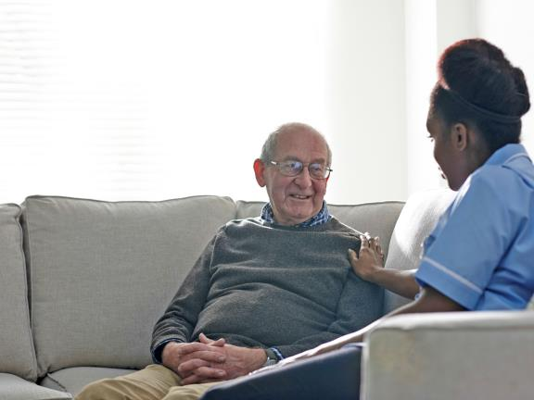
Checkpoint
Page 13

Slide 19

2: Hallucinations and Delusions
Reality is merely an illusion
Page 14

Slide 20

Hallucinations
Feeling
Smell
See
Hear
Taste
Page 15-16

Slide 21

Delusions
What do you see?
Page 16

Slide 22

Do not overlook or dismiss that the claim could be
real.
Page 16

Slide 23

Checkpoint
Page 13

Slide 24

3: Setting the Tone
Gentle approach + compassion + understanding = quality of life
Page 18

Slide 25
You and Caregiving
Empathy
Dependability
Patience
Strength
Flexibility
Creativity
Page 19-20

Slide 26

Self Care
Reduce Personal Stress
Learning from Our Emotions
Setting Goals
Exercise
Nutrition
Support
Asking for and Accepting Help
Communicate Effectively
Page 20-23

Slide 27

The Environment
Emotions
Noise
Smells
Distraction
Lighting
Temperature
Colors
Patterns
Pictures
Signs
Page 23-24

Slide 28

Checkpoint
Page 25

Slide 29

4: Working with Families
Dementia has a huge impact on families.
Page 26

Slide 30
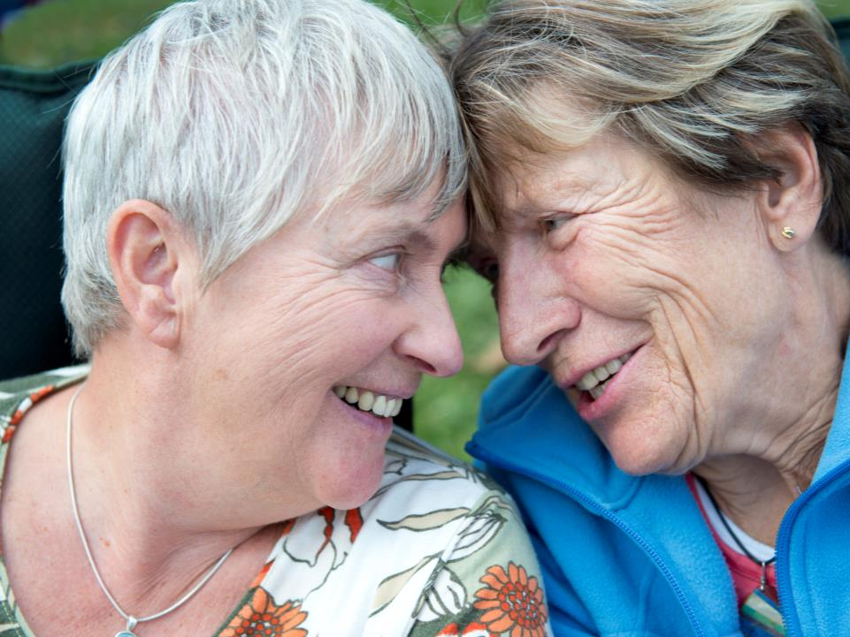
Get to Know the Family
The family unit might expand beyond what you think about as the traditional family unit of spouse and adult children.
Page 26-27

Slide 31
The Iceberg
Food preferences
Physical features
Clothes
Gender
Age
Spirituality
Thoughts on aging
Sense of self
Concepts of aging
Emotional responses
Rules for social interaction
Decision-making process
Approaches to problem-solving
Concept of justice
Perceptions of aging, mental
disorders, and disability
Perceptions of roles related to age,
gender, class, etc.
And much, much more…..
Page 27

Slide 32

Families Need
Provide quality care for their loved one.
Trust. Communication. Understanding.
Page 27-29

Slide 33

Checkpoint
Page 29

Slide 34
Break

Slide 35

Module 2: Living with Dementia
Lesson 5: Sexuality and Intimacy
Lesson 6: Medications, Treatments & Therapies
Lesson 7: Activities of Daily Living
Page 30

Slide 36
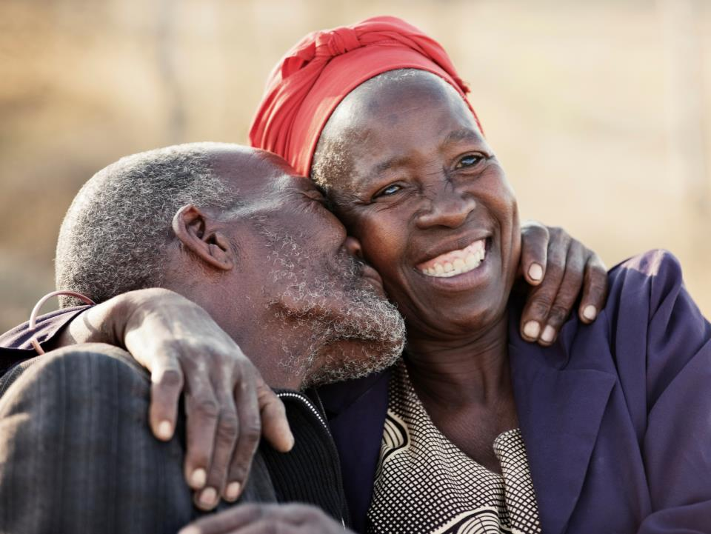
5: Sexuality and Intimacy
Sexuality is a normal human need.
Page 31

Slide 37

Sexuality
Intimacy
Sexualized
Sex drive
Sexual acts
Gender identity
Roles
Sexual orientation
Eroticism
Pleasure
Reproduction
Giving and receiving of love and affection
Caring touch
Empathic understanding
Comfort
Feeling of safety
Need for touch
Need for intimacy
Something else that is not sexual in nature
Page 31-32

Slide 38
Your Guiding Principle
DO
NO
HARM
Page 32

Slide 39

Attitudes and Stigma
…look beyond your own bias, protect from harm,
determine capacity to consent, maintain privacy
& promote independence…
Page 32-33

Slide 40
Maybell Wiggin is 77 years old and has Vascular Dementia. She recently moved into an assisted living facility because her husband could no longer provide the care she needed. Maybell does not recognize her husband and has recently shown interest in Lance, a male resident at the facility. Earlier today you found the two cuddling and kissing in Maybell’s bed.
How might you deal with this situation?
Page 33

Slide 41

Changes
Reduced or Increased Interest,
Sexual Aggression, Inhibitions
Coping and Frustrations
Page 33-34

Slide 42
Sonny Tricket, who has been in your care for the last two years, was diagnosed with Alzheimer’s disease at age 76. His disease has progressed quickly over the last few months since his wife passed away. One evening, Mr. Tricket is shifting in his seat and pulling at his pants. He begins to pull his pants down.
What are some possible reasons he may be behaving in this way that do not involve sexual arousal?
Page 34

Slide 43
Essentials
Client Rights
Right to express sexuality without fear of judgement.
Consent
Both individuals involved must consent.
Decision Making Capacity
Make own decisions
Free of Duress
No threats, violence, constraints or other action against will or better judgement.
Page 34-35

Slide 44

Abuse and Other Unacceptable Sexual Behaviors
Ask if the person with dementia is:
  Comfortable with the relationship?
  Able to avoid being treated unfairly or exploited?
  Capable of saying no?
  Being treated with respect, dignity, and is given privacy?
Page 35-36

Slide 45
Cristi Stuck, a 90 year old woman with vascular dementia has been affectionate on and off with a male resident, also with vascular dementia. They both seem to be at the same stage of dementia. Their emotions seem to change daily and at times, one or both do not recognize each other.
How do you manage this relationship?
Page 36

Slide 46

Your Responsibility
Advocate
for the person with dementia
Page 36

Slide 47
Washington State Law
Report all concerns of suspected non-consensual sexual contact and/or relationships.
Page 38

Slide 48

Checkpoint
Page 38

Slide 49

6: Medications, Treatments & Therapies
There are many possibilities to manager care.
Page 39

Slide 50

Conventional Medicine
There is no cure for dementia.
Aricept (donepezil)
Exelon (rivastigmine)
Razadyne (galantamine)
Namenda (memantine)
Page 39-40

Slide 51
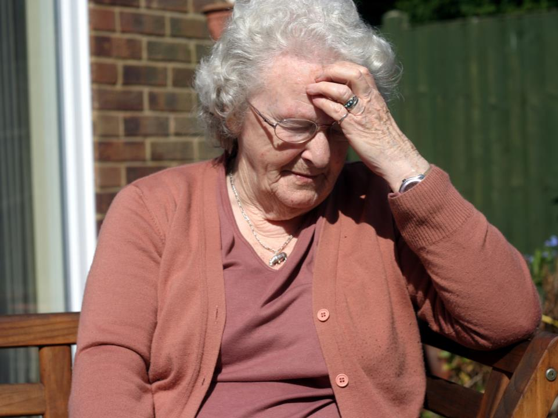
Side Effects
Any life threatening drug reaction or side effect should be treated as a medical emergency!
Call 911.
Page 41

Slide 52
Earlier this week, Jacquline Pool started an increased dose of Donepezil for her Alzheimer’s. Yesterday she started complaining about her stomach and holding her stomach area. She is having diarrhea and refused to eat breakfast and lunch today.
What should you do?
Page 42

Slide 53
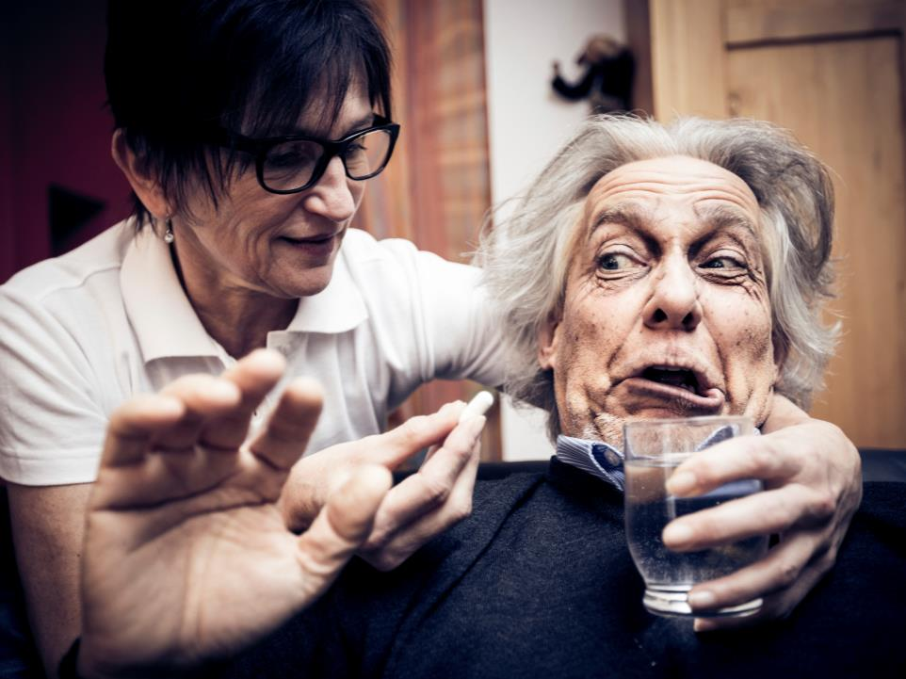
Chemical Restraint & Refusal
Chemical Restraint
is considered abuse
in the state of Washington
… Individuals have the right to refuse medication.
Page 43

Slide 54
Over the last six months, Dania Denner continues to get frustrated toward you and other staff, threatening several times a week that she will call the police on someone for looking at her wrong. You did not sleep well last night and her constant moving and fidgeting is getting on your nerves.
Is it acceptable to give her some Benedryl or other over the counter drug to get her to nap so you can have a break? Why?
Page 43

Slide 55

Non-Drug Therapies
Natural Medicine
Cannabis
Holistic Therapies
Nutrition
Page 43-46

Slide 56

Checkpoint
Page 47

Slide 57

7: Activities of Daily Living
“Success is the sum of small efforts – repeated day in and day out.”
– Robert Collier
Page 48

Slide 58

Helping with ADLs
A lifetime of routines and
daily habits.
Page 48-49

Slide 59

Helping with ADLs
The care you provide should be focused on each person as an individual.
Page 49-50

Slide 60

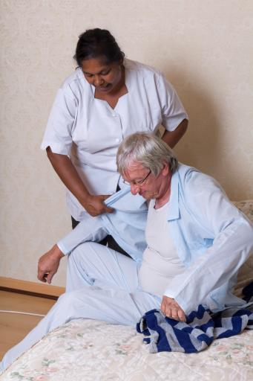
Bathing, Dressing
Page 52-53

Slide 61
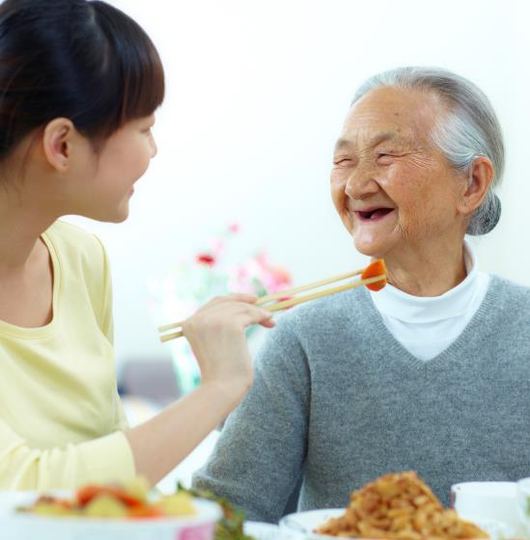


Eating, Oral Care, Toileting
Page 54-55

Slide 62

Checkpoint
Page 57

Slide 63
Lunch

Slide 64

Module 3: Fostering Communication and Understanding
Lesson 8: Communicating with People who Have Dementia
Lesson 9: Trauma-Informed Care
Page 58

Slide 65

8: Communicating with People with Dementia
Communication
is more than a
verbal exchange.
Page 59

Slide 66

8: Communicating with People with Dementia
Page 59

Slide 67

Communication and Dementia
Verbal Communication
Spoken Words
Nonverbal Communication
Tone of Voice, Body Language, and Proximity
Page 59

Slide 68
Role-Play! Pair up. Each choose a role and interact using verbal and nonverbal communication for one minute. Switch roles for one minute.
Caregiver: You are in a hurry to finish ADLs with B. Miley so you can get to breakfast. You turn to the closet to put away some clothes.
B. Miley: You have Alzheimer’s disease. You are feeling tired and just woke up.
Page 59

Slide 69
Phases and Communication
Early
Middle
Late
Page 60

Slide 70
Phases and Communication
1
Early
Comprehension
Language
Social Changes
Complex conversations
Humor & sarcasm
Thinking what to say
Words and related words
Correct mistakes
Changing the subject
Repeat
Clichés
Covering
Noah Granbury is sitting at the dining room table with a cup of coffee. He asks his wife, Wendy, to please pass him the salt for his coffee. She looks confused and he shakes his head and asks her for the sugar instead. Wendy is noticing that he has been having difficulty with words a lot more recently. She looks concerned and asks if he is ok. He changes the subject by asking her if she has seen the newspaper. Discuss the ways Noah’s communication is impacted by early phase dementia.
Page 60-61

Slide 71
Phases of Communication
2
Middle
Comprehension
Day to day conversations
Attention
Noise
Reading
Facial expressions
Language
Names and words
Processing
Repeating
Social Changes
Forget questions
Talking
Noah Granbury was diagnosed with Alzheimer’s at age 76. He is now 79 and is now in your care. This afternoon you noticed him squinting at his newspaper and put it down with a frustrated look. The TV is on and there are people talking. He leaves the room. You approach Noah to see if you can help him. He turns away from you and starts talking about working at the grocery store. Discuss the ways Noah’s communication is impacted by middle phase dementia.
Page 61

Slide 72
3
Phases of Communication
Late
Comprehension
Meaning of words
Unaware
Language
Repeating
Language of origin
No speaking
Social Changes
Awareness of social interactions
Withdraw partially or completely
May communicate in other ways
Noah Granbury is now 85 and still in your care. He often sits in his chair looking out the window. His wife, Wendy, comes to visit him often. She sits next to him and he glances at her, not recognizing her, then looks back toward the window. Discuss the ways Noah’s communication is impacted by late phase dementia.
Page 62

Slide 73
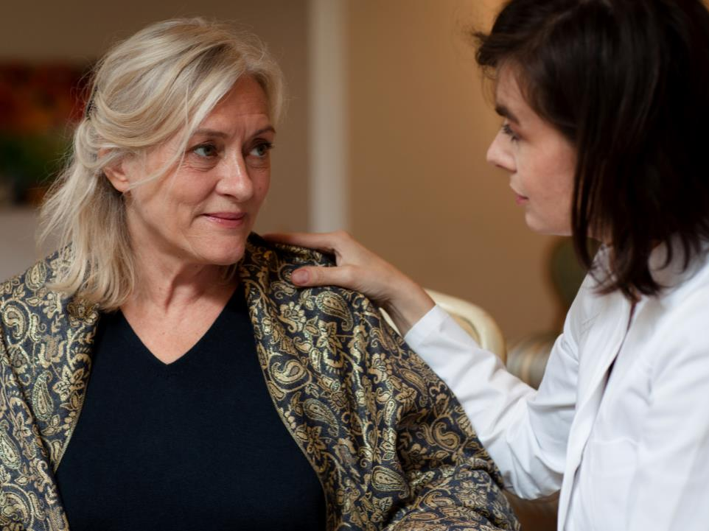
Strategies and Tips
Do NOT
take anything
personally
Page 62

Slide 74
Strategies
Gestures
Give Info
Get Info
Approach
Listen
Respect
Environment
Strategies
Page 63-65

Slide 75

Avoid or Reframe Open-ended Questions
Do you want cake or pie?
Do you want coffee or juice?
Do you want to wear the red or blue shirt?
Page 65

Slide 76

Avoid Reason, Logic, or the Mention of Time
Page 66

Slide 77

Ask, Rather Than Tell the Person What to Do
Would you like to walk with me?
Page 67

Slide 78

Say Less
When you give blah, the blah with blah blah blah to blah more blah small blah of the blah. That is why blah should blah kept blah and blah.
Page 67

Slide 79

Gentle Deception
I want to go home.
I don’t know where I am. My family is probably worried about me. Get me out of here, let me go home now!
Page 68

Slide 80
Mrs. Hoyton’s husband died several years ago. Every morning she asks staff, “Where is my husband? He is supposed to pick me up.”
Using Gentle Deception, how might you respond to Mrs. Hoyton?
Page 68

Slide 81

Checkpoint
Page 69

Slide 82

9: Trauma Informed Care
Your past and an individual’s past experiences will influence current thinking, behaviors and actions.
Page 70

Slide 83
In groups: Discuss how each event might impact the individual with dementia and the care you provide to them.
Loss of a child or spouse
Holocaust
Victim of domestic violence
Victim of sexual abuse
Traumatic accidents such as train, plane crashes etc.
Military war experience
Other
Page 70

Slide 84

Coping and Culture
Coping mechanisms are ways
that people deal with stress and trauma
Culture can shape how a person
Experiencing the trauma reacts and responds
Page 71

Slide 85


Trauma Informed Care
62%
What has happened to you and
how can I support you?
Page 71

Slide 86
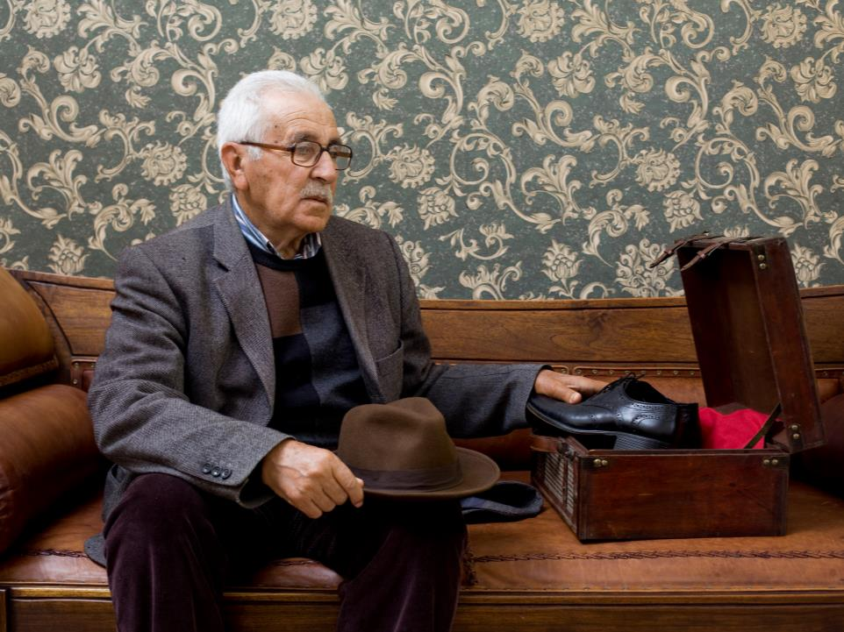
A Culture Shift
Individuals, their personal story, their history, and culture must be separated from their condition(s) and protected from physical harm and re-traumatization.
Page 72

Slide 87
You have been hearing from others that Ms. Denner has been screaming every time someone tries to shower her. You are not looking forward to assisting with her shower today. You try to approach Ms. Denner with a smile and you use a towel around her to help with possible privacy concerns. She still screams in the shower. After talking with your supervisor and the family, you find out that Ms. Denner is a concentration camp survivor and her memory of white tiled shower rooms were gassing chambers.
Discuss ways that you might handle this in the future.
Page 72

Slide 88
Principles of Trauma Informed Care
Principles of TIC
Safety
Trustworthiness
Choice
Collaboration
Empowerment
Page 72-73

Slide 89
Michael Smith is 79 years old and has Lewy Body Dementia. When he was a child, his father was an alcoholic, often physically abused his mother in front of him, and sexually abused Michael. His father later went to jail and his mother suffered from depression. He often has conflict with staff and says that you or others want to hurt him.
Discuss ways that you might use the five principles of trauma informed care and support Michael to improve his quality of life.
Page 73

Slide 90

Checkpoint
Page 75

Slide 91
Break

Slide 92

Module 4: Challenging Behaviors
Lesson 10: Approaching Behaviors
Lesson 11: Tips for Dealing with Specific Challenging Behaviors
Page 76

Slide 93

10: Approaching Behaviors
Peace cannot be kept by force; it can only be achieved by understanding.
- Albert Einstein
Page 77

Slide 94
Imagine that you are checking into a hotel. You have been traveling all day and you are tired. You put your suitcase in the closet and crawl into one of the beds. You pull the covers over and turn the light out. It is not long before you are sleeping soundly. In the morning, you open your eyes and you roll over to find the housekeeper from the hotel trying to get you out of bed.
What would you do?
Page 77

Slide 95

Exploring Behaviors
Individuals with dementia use behaviors to communicate feelings, emotions and personal needs
Page 77

Slide 96
Strategy for Approaching Behaviors
Stop
Identify
Action
1
2
3
Page 77

Slide 97
Strategy for Approaching Behaviors
Stop
Stop or pause
Calm yourself
1
Page 77

Slide 98
Strategy for Approaching Behaviors
What are ways to calm yourself?
1
Page 78

Slide 99
Strategy for Approaching Behaviors
Identify
What need or desire does the individual have that is not being met?
What are the physical, environmental, and emotional triggers?
Were other people involved?
Is this a new behavior?
Are there any patterns that you can see?
What happened just before the behavior started?
2
Page 78

Slide 100
Strategy for Approaching Behaviors
What are some of the common triggers to look for that may be causing a behavior?
2
Page 79

Slide 101
Strategy for Approaching Behaviors
Action
Adapt
Give space
Soothe and comfort
Reassure
Distract or redirect
Encourage
Protect and support others
Get help
Minimize or eliminate triggers
3
Page 80

Slide 102
Rosella Borowski has been in your care for almost two years. She is now 73 and her Alzheimer’s has progressed and she is now unable to remember new information for even two or three minutes. Rosella often talks to you about starting college soon. She talks about saving her money to go to school to become an artist. Today, you approach her as she is pulling items out of a drawer. She looks at you suspiciously and accuses you of stealing her paintbrushes and hiding them from her.
Use the three steps to approach this behavior.
Page 82

Slide 103
Prevent or Minimize Challenging Behaviors
Objectively writing down what happened and what actions you took gives everyone a record.
Page 82

Slide 104

Checkpoint
Page 83

Slide 105

Tips for Dealing with Specific Behaviors
Nothing other people do is because of you.
It is because of themselves.
Page 84

Slide 106
Behaviors
Anger
Combative
Crying
Disrobes
Eats non-edible
Hallucinations
Inappropriate Toileting
Injures Self
Intimidating
Mood Swings
Repetitive, Anxious…
Repetitive Movements…
Resistive to Care
Rummages…
Seeks Vulnerable Sexual Partner
Sexual Acting Out
Spitting
Unrealistic Fears or Suspicions
Unsafe Smoking
Up at Night
Verbally Abusive
Wanders and Exist Seeking
Delusions
Page 84-89

Slide 107

Checkpoint
Page 89

Slide 108
Exam and Evaluation

